Slide 1
AlphaFold Confidence Metrics
Can they accurately predict good binders?

Slide 2
AlphaFold Confidence Metrics
Overview
AlphaFold2 confidence metrics:
  pLDDT : Local confidence for a residue’s geometry
  PAE : Confidence in relative positioning between two residues
AlphaFold-Multimer
  pTM: Confidence for overall structure of the complex
  ipTM: Confidence for how correctly two chains are positioned relative to each other
For binder design, ipTM is the primary metric

Slide 3
Predicted local distance difference test pLDDT
A per-residue measure of local confidence (Higher is better)
Estimates how well the prediction would agree with an experimental structure
Based on the local distance difference test Cα (lDDT-Cα)
  Measures how close a predicted protein structure is to the experimentally determined one (reference structure)

Slide 4
lDDT-Cα
Takes each Cα (alpha carbon: first carbon atom attached to a functional group) atom in the reference structure:
Look at all other Cα atoms that are within a cutoff radius in the reference.
Typically this cutoff is around 15 Å.
These are the “neighbors” for that residue.
For each of those neighboring pairs, compare the distance:
  Distance in the reference structure
  Distance in the predicted structure
Compute the absolute difference between those two distances.
Check whether that difference is smaller than a set of tolerance thresholds, usually:
  0.5 Å
  1 Å
  2 Å
  4 Å
For each threshold, Count how many pairs pass
Average across thresholds
Average across residues
That final average is the lDDT-Cα score

Slide 5
pLDDT
lDDT-Cα requires a reference structure (ground truth) to compare a predicted structure to
For each residue, predict a probability distribution over lDDT bins (using internal features)
  e.g. bins can be 0-10, 10-20,..
  e.g. For a residue: 5% chance lDDT is 10-20, 15% chance lDDT is 50-60,…
Then, convert distribution into an expected score
Final pLDDT score for the whole structure is the avg over all residues

Slide 6
pLDDT
AlphaFold’s lDDT head takes the single-residue embedding vector for each residue and feeds it through a small feedforward network
That network outputs logits over discrete lDDT bins
Then softmax turns logits into a probability distribution

Slide 7
Predicted aligned error pae
1. Pair representation
Inside the model, AlphaFold maintains a pair embedding for every residue pair (i, j).
This embedding encodes:
  Co-evolutionary signal
  Geometric constraints
  Attention patterns
  Internal uncertainty signals
  How strongly i and j are geometrically linked
By the time the structure is predicted, this pair representation already ‘knows’ how constrained that relationship is

Slide 8
Predicted aligned error pae
2. The PAE head
  There is a dedicated prediction head that:
  Takes the pair embedding for (i, j)
  Passes it through a small neural network
  Outputs logits over error bins
The bins correspond to distance ranges like:
  0–0.5 Å
  0.5–1 Å
  1–2 Å
  2–4 Å
  ...
  up to ~30 Å
After softmax, we get a probability distribution over error magnitudes

Slide 9
Predicted aligned error pae
3. Convert distribution to expected error
The model computes:
  PAE(i, j) = sum over bins of
  (probability * bin center)
This gives the predicted aligned error in Ångstroms

Slide 10
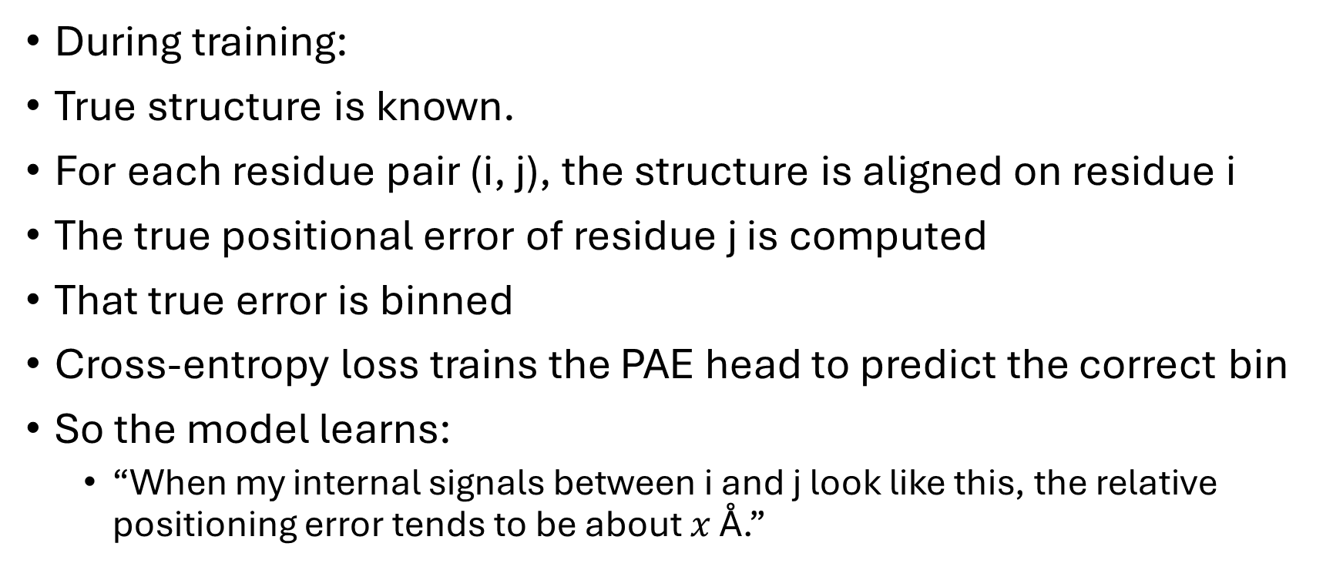
Predicted aligned error pae
How it is trained
During training:
True structure is known.
For each residue pair (i, j), the structure is aligned on residue i
The true positional error of residue j is computed
That true error is binned
Cross-entropy loss trains the PAE head to predict the correct bin
So the model learns:
  “When my internal signals between i and j look like this, the relative positioning error tends to be about $x$ Å.”

Slide 11
Predicted aligned error pae
Why it works
If two residues are:
  In a rigid domain with strong co-evolution : Low predicted error
  In different flexible domains : High predicted error
  Across a weakly supported interface : Moderate to high error
The model learned these patterns statistically

Slide 12
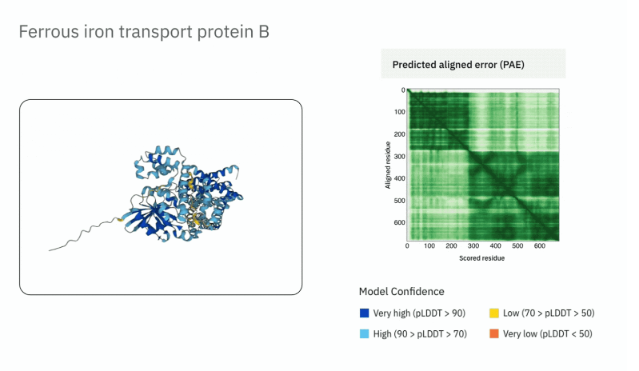
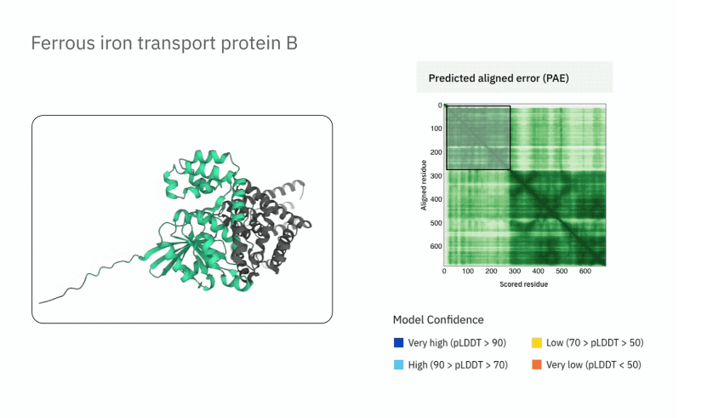
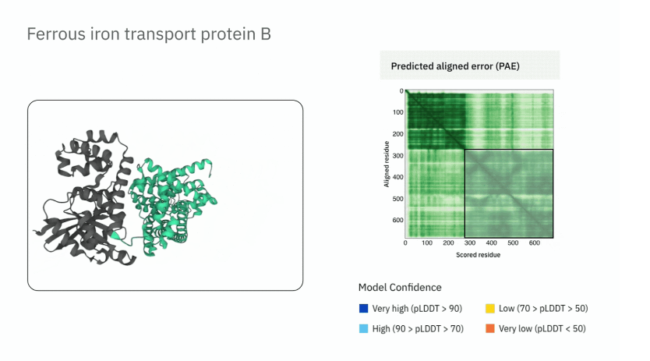
Predicted aligned error pae
Different regions have different pae

Slide 13
AlphaFold-Multimer
Predict the structures of protein complexes (docking)
2 new metrics:
  Predicted template modelling (pTM) score
  Interface predicted template modelling (ipTM) score
Both are derived from a measure called the template modelling (TM) score
  Measures the accuracy of the global structure of the protein and is relatively insensitive to localised inaccuracies

Slide 14
Template Modelling score
Metric used to measure how similar two protein structures are in 3D space
  Designed to fix problems with RMSD
  Higher is better
Sum over residues of
1 / (1 + (distance / d₀)²)
Where:
  distance = Cα distance between aligned residues
  d₀ = length-dependent scaling factor
Output a number b/w 0 and 1
Large distances contribute very little
Close residues contribute near 1
That is why one bad loop does not destr

Slide 15
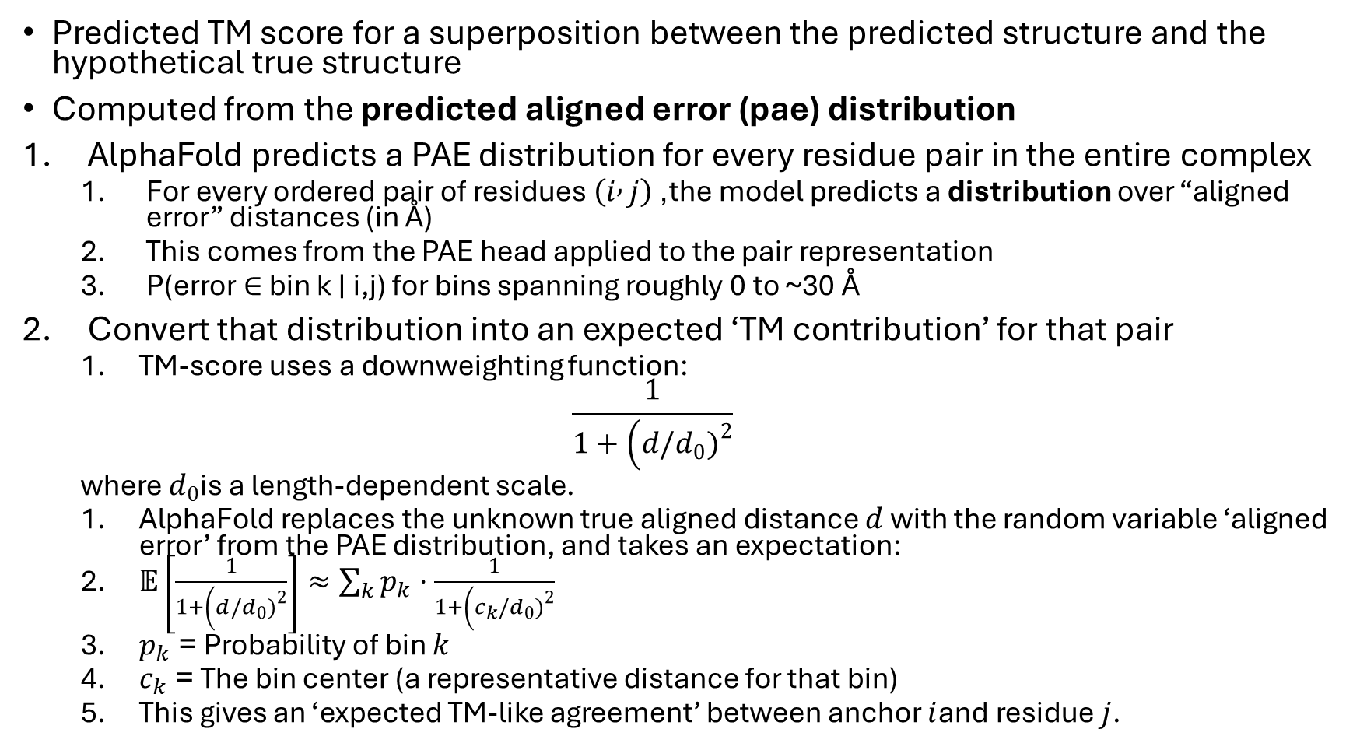
Predicted TM score pTM
Predicted TM score for a superposition between the predicted structure and the hypothetical true structure
Computed from the predicted aligned error (pae) distribution
AlphaFold predicts a PAE distribution for every residue pair in the entire complex
  For every ordered pair of residues $\left(i , j\right)$, the model predicts a distribution over “aligned error” distances (in Å)
  This comes from the PAE head applied to the pair representation
  P(error ∈ bin k ∣ i,j) for bins spanning roughly 0 to ~30 Å
Convert that distribution into an expected ‘TM contribution’ for that pair
  TM-score uses a downweighting function:
  $$\frac{1}{1+\left(d/d_{0}{\left.)\right.}^{2}\right.}$$
  where $d_{0}$is a length-dependent scale.
  AlphaFold replaces the unknown true aligned distance $d$with the random variable ‘aligned error’ from the PAE distribution, and takes an expectation:
  $𝔼\left[\frac{1}{1+\left(d/d_{0}{\left.)\right.}^{2}\right.}\right]≈\sum_{k}{p_{k}}⋅\frac{1}{1+\left(c_{k}/d_{0}{\left.)\right.}^{2}\right.}$
  $p_{k}$= Probability of bin $k$
  $c_{k}$= The bin center (a representative distance for that bin)
  This gives an ‘expected TM-like agreement’ between anchor $i$and residue $j$.

Slide 16
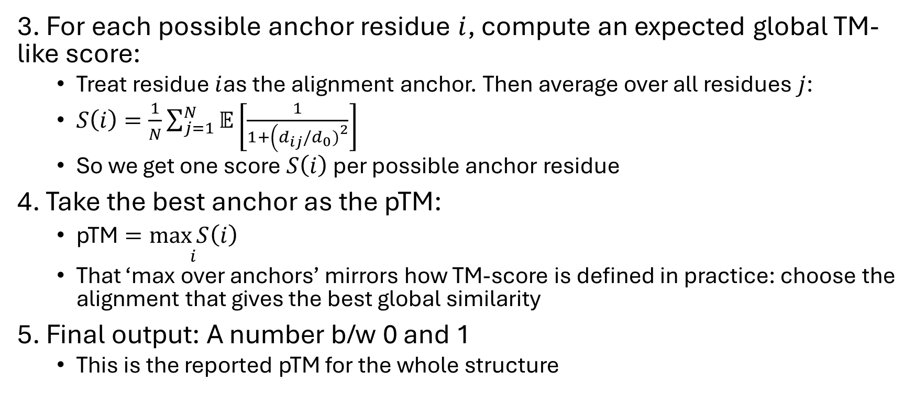
Predicted TM score pTM
3. For each possible anchor residue $i$, compute an expected global TM-like score:
  Treat residue $i$as the alignment anchor. Then average over all residues $j$:
  $S\left(i\right)=\frac{1}{N}\sum_{j=1}^{N}{𝔼}\left[\frac{1}{1+\left(d_{ij}/d_{0}{\left.)\right.}^{2}\right.}\right]$
  So we get one score $S\left(i\right)$ per possible anchor residue
4. Take the best anchor as the pTM:
  $\text{pTM}=\underset{i}{\max{S\left(i\right)}}$
  That ‘max over anchors’ mirrors how TM-score is defined in practice: choose the alignment that gives the best global similarity
5. Final output: A number b/w 0 and 1
  This is the reported pTM for the whole structure

Slide 17
Interface predicted TM score ipTM
Computation:
  Same as pTM, but only look at inter-chain pairs
  i.e. Ignore residue pairs from the same chain
Ignores residue pairs w/in the same chain and focuses purely on:
  Relative positioning between different chains
  Interface geometry confidence

Slide 18
pTM vs ipTM
pTM measures geometric confidence of the complex AFTER binding
It does not predict:
  Binding affinity
  Thermodynamic stability
  Whether two proteins will bind if separated in solution

Slide 19
Confidence metrics in practice
For example:
We have two chains A and B:
Each chain folds well on its own:
  Their individual pLDDT scores can be high
  The complex’s pTM score can also be high
    Because intra-chain pairs vastly outnumber inter-chain pairs, the overall pTM can stay fairly high
    pTM is dominated by intra-chain geometry, not suited for binding/docking
But if docking is uncertain:
  The complex’s ipTM score can be low

Slide 20
Confidence metrics in practice
High pTM + High ipTM
  Confident fold and confident docking
High pTM + Low ipTM
  Confident monomers, uncertain interface
Low pTM + Low ipTM
  Overall structural uncertainty
Low pTM + High ipTM
  Interface docking geometry is confident, but overall fold or domain arrangement is uncertain

Slide 21
Possible Limitations
Confidence metrics depend on AlphaFold’s training data
  May not be as good for de novo proteins

Slide 22
Literature review of New Protein Design Methods
Literature Review focusing on new Protein Design methods that justify their improvement using AF confidence metrics (pLDDT, ipTM)
If many publications at top venues report improvements using AF metrics, it should be fine for MutaCraft to do so as well

Slide 23
PepPrCLIP
Science Advances 2025
PepPrCLIP is a peptide design pipeline
Compares its binders to RFDiffusion’s using AFM’s ipTM
  An example of a publication at a top venue that uses ipTM to show it’s better than a previous approach
De novo design of peptide binders to conformationally diverse targets with contrastive language modeling
Science Advances (Jan 2025)
https://www.science.org/doi/10.1126/sciadv.adr8638

Slide 24
BindCraft
Nature 2025
Designed binders were filtered using AF2 metrics (including pLDDT & ipTM)
Binders were experimentally validated, showing a correlation b/w pLDDT & ipTM and better experimental binding affinity

Slide 25
PepMLM
PepMLM used AF-based docking metrics including pLDDT and ipTM
pLDDT & ipTM are “verified metrics” that “function as critical indicators of the structural integrity and the potential interface binding affinity of the peptide–protein complex”
Target sequence-conditioned design of peptide binders using masked language modeling
Nature Biotechnology (Aug 2025)
https://www.nature.com/articles/s41587-025-02761-2

Slide 26
AlphaDesign
Molecular Systems Biology 2025
AlphaDesign is a protein design framework
Uses AF’s confidence metrics as an optimisation signal
AlphaDesign: a de novo protein design framework based on AlphaFold
Molecular Systems Biology (Jun 2025)
https://link.springer.com/article/10.1038/s44320-025-00119-z

Slide 27
More papers that were published despite no experimental binding affinity validation
ProDualNet Briefings in Bioinformatics 2025
  evaluates designs in silico and explicitly uses pLDDT and ipTM as ranking/quality metrics
  Outperforms baseline (ProteinMPNN variants etc.) using these metrics
Automated and modular protein binder design with BinderFlow PLOS Computational Biology 2025
Rapid and accurate prediction of protein homo-oligomer symmetry using Seq2Symm Nature Communications 2025
APM: An All-Atom Generative Model for Designing Protein Complexes ICML 2025

Slide 28
Conclusion
It’s common for publications that are proposing new protein design methods to use AF confidence metrics, without experimental validation

Slide 29
Literature review of AF confidence metrics
Literature Review focusing on experimental data similar to ours:
Protein-peptide docking
Peptide binders of small length (20)
Targets similar to ours:
  CCR4
  CRTH2
  ICOS
  CD4
Can the combination of pLDDT + ipTM predict experimental binding affinity?

Slide 30
EvoBind2
EvoBind2 designs peptide binders for a target protein
Binders evaluated using pLDDT & AlphaFold-Multimer (AFM) Loss
Experimentally validated their designed binders
Binder lengths were 8-20aa
pLDDT is a good predictor of binding affinity
Design of linear and cyclic peptide binders from protein sequence information
Nature (July 2025)
https://www.nature.com/articles/s42004-025-01601-3

Slide 31
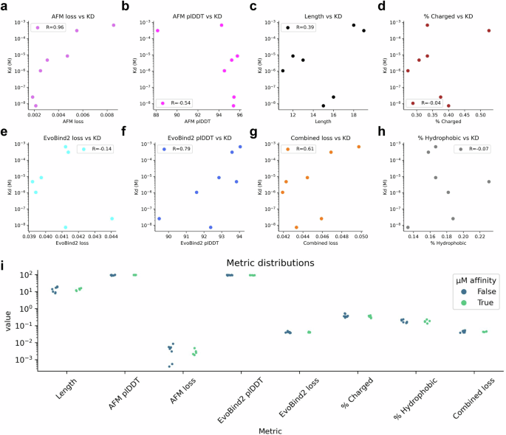
EvoBind2 Results
Spearman correlation:
  Ranging from -1 to +1, it assesses how well the relationship between variables can be described using a monotonic function. Unlike Pearson’s correlation, it does not require linear relationships or normal distribution, making it robust to outliers

Slide 32
EvoBind2 Results
The best indicator for affinity is the AFM loss, with a Spearman correlation of 0.96
Positive correlation (higher plDDT, higher affinity) with AFM plDDT (R = −0.54)
Lower correlation with PAE (R=0.51)
Results show that pLDDT can be a good indicator of binding affinity for small-length peptide binders
They did not use pTM or ipTM

Slide 33
More papers
PepMLM: Target sequence-conditioned design of peptide binders using masked language modeling Nature Biotechnology (Aug 2025)
  Used pLDDT & ipTM
  In a peptide design benchmark, higher ipTM scores were used to identify successful binders, and designs with higher ipTM achieved higher hit rates
Protein structure prediction implicitly define binding energy functions ICLR 2025
  AlphaFold confidence metrics are predictive of biological interface quality and binding behavior
Evaluation of AlphaFold-Multimer prediction on multi-chain protein complexes Bioinformatics (July 2023)
  large benchmark study on AlphaFold-Multimer shows that interface-focused confidence metrics can identify correct interfaces more reliably than global structural confidence alone
  Suggests that a combination of pLDDT + ipTM would be good
AlphaFold-Multimer accurately captures interactions and dynamics of intrinsically disordered protein regions PNAS (Oct 2024)
  explicitly shows that AlphaFold-Multimer confidence scores (ipTM) correlate with true interaction quality

Slide 34
More Papers
Improving de novo protein binder design with deep learning
Nature Communications 2023
  They report that using AlphaFold2 or RoseTTAFold to assess whether designs adopt the monomer fold and bind the target “increases design success rates nearly 10-fold”
AlphaFold-Multimer predicts cross-kingdom interactions at the plant-pathogen interface Nature Communications 2023
  Uses ipTM+pTM thresholds and pLDDT patterns to screen predicted complexes, and then confirms several predicted inhibitors experimentally

Slide 35
Conclusion
Many publications show that AF confidence metrics can be good predictors of a experimentally validated good binders

Slide 36
Adaptyv’s Protein Design Competition
(Dec 2024)
Adaptyv is a Swiss protein engineering cloud lab @ the University of Lausanne
They held a Protein Design Comptetition where 130 designers created de novo in silico binders for EGFR
https://www.adaptyvbio.com/blog/po104

Slide 37
Adaptyv’s Protein Design Competition
(Dec 2024)
They tasked designers to create new protein binders for EGFR, an important binding target for therapeutic proteins.
They then ranked them based on a weighted score of
  AlphaFold2’s ipTM and iPAE (pae but only for inter-chain pairs) metrics
  ESM2 pseudolikelihood (ESM2 PLL), a measure of how “natural” a sequence looks like given ESM2 learned distribution
From these, they chose 400 sequences to be tested experimentally in their lab
  The top 100 as determined by the rankings
  Another 300 handpicked by them

Slide 38
Adaptyv’s Protein Design Competition
Results (Dec 2024)
Out of 400 tested proteins, 378 expressed successfully (95%) and 53 of these bound to their target EGFR (14% success rate).
This represents a 5x improvement in binding success compared to just three months ago.
The best designs even matched or exceeded the performance of Merck's Cetuximab, a clinically approved therapeutic antibody

Slide 39
Adaptyv’s Protein Design Competition
Results (Dec 2024)
Top 3 spots were dominated by redesigned binders, from known antibody therapeutics, to nanobodies and binders from nature
Suggesting mutational strategies beat out de novo ones

Slide 40
Adaptyv’s Protein Design Competition
Results (Dec 2024)
They also wanted to see whether the new metrics had an impact on the number of resulting binders
Keeping in mind that they only had 1 target protein:
“The causal relationship is still blurry. Did any of these metrics (ipTM, iPAE, ESM2 PLL) play a actual role in predicting binders?”
“But, we can highlight our main conclusion: landing in the top 100 w.r.t in silico metrics played no detectable role in increasing the binding affinity.”
Both in this competition and across the field, we still struggle to predict binding success through computational metrics

Slide 41
Adaptyv’s Nipah Protein Design Competition
(Dec 2025)
They’re currently testing all 1200 selected designs
Boltz-2 ipSAE score for filtering
Many participants evaluated their designs locally prior to submission and encountered reproducibility issues of the ipSAE score
  Model can yield slightly different results depending on hardware configuration and random seeds

Slide 42
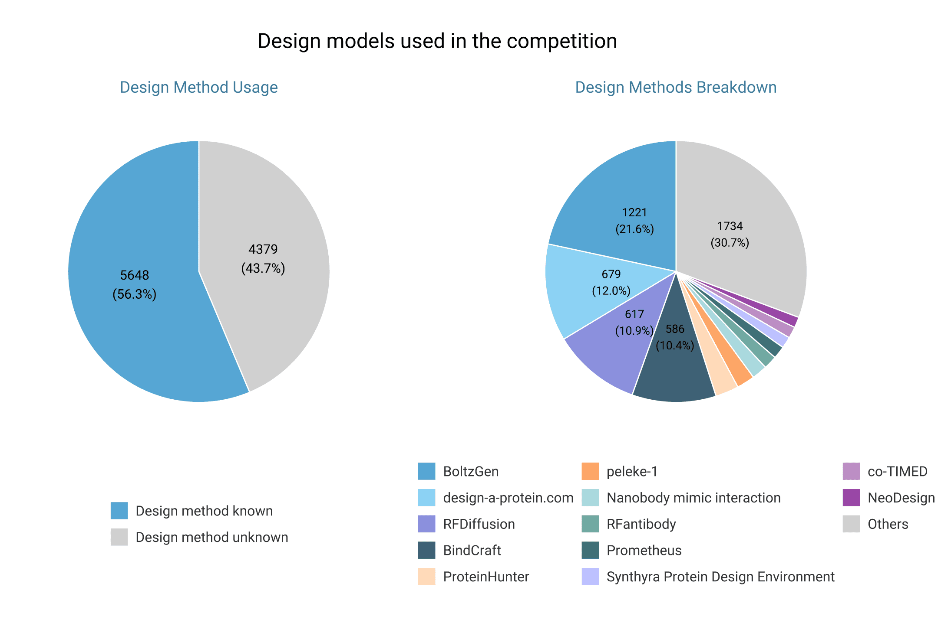
Adaptyv’s Nipah Protein Design Competition
(Dec 2025)

